Slide 1


DART - PROGRAMMING LANGUAGE

Slide 2
DART
Open Source General Purpose programming language. This can be used with any framework like angular, nodeJS and flutter.
OOPS (object-oriented programming) + Functional programming + Async programming + reactive programming
Statically Typed language but also mimic dynamic type.
Type Inference Feature.
Null Safety Feature, null awarer (?) operator, bang (!) operator.

Slide 3

DATA TYPES
Dart mainly have 2 types of data types
Basic Data Types
int
double
string
bool
dynamic
Advance Data Types
list
set
map

Slide 4
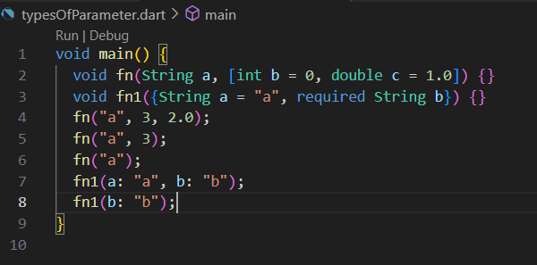
TYPES OF ARGUMENTS
Required Positional Parameters - a in fn
Optional Positional Parameters - b,c in fn
Required Named Parameters - b in fn1
Optional Named Parameters - a in fn1

Slide 5

FAT ARROW FUNCTION
Dart uses the fat arrow notation ( => ) to define a single expression in a function. It is a neat method to write a single-line function expression.

Slide 6
Functional Programming
Function are first class citizen, they are treated as a data type. we can make variables for functions.
Functions are treated as data type so they can be returned through a function.
01
02
Functions are treated as data type so they can be passed as an argument in another function.
We have a concept of pass now and call later
03
04

Slide 7
OOPS in Dart
Late keyword - used to indicate that a non-nullable variable will be initialized later in the code
Named constructors
Way to define private parameters - name of variable starts with _ , to make variables private.
getter & setters - we also have different syntax for defining setters & getters.

Slide 8
Asynchronous Programming
Dart is a single-threaded language which allows us to handle multiple tasks at a time asynchronously.
Asynchronous programming allows tasks to run concurrently without blocking the main program.
'async' marks a function as asynchronous, 'await' pauses execution until an asynchronous operation completes.
Async keeps UI responsive by preventing blocking of the main UI thread.
Async manages tasks without requiring a separate thread (backgrond threads) per operation (time consuming tasks).

Slide 9

THANK YOU

